Slide 1

Analysis on Mobile Data

Slide 2

About me
Background ?
Hi, I'm Yamini. I hold an MBA postgraduate degree….
Why you want to learn Data Science?
Even though I am MBA I choose Data Science because Data Science skills are highly valued in the job market and combing them with an MBA can lead to exciting career opportunities and a competitive advantage in the job market
Linkedin profile url:
www.linkedin.com/in/yamini-j-9876z5432a10

Slide 3

Agenda
Business Problem
Based on the trends in mobile phone purchases .I would like to analyze customer reviews on different mobile phone models To determine which features are most important to the consumers while choosing a mobile phone and to examine which mobile phone brands are popular and mostly using although there are many different brands i want to give a clear suggestion to bought a mobile based on their budget and reviews we can easily predict the features what the consumers are expecting.
Use case domain
case domain : Electronics

Slide 4
Objective of the Project
The main objective of the project is to make it easy to buy a mobile phone and also
improve the customer satisfaction by launch a new product based on their features they want
Web Scraping –flipkart
Flipkart Private Limited is an Indian e-commerce company, headquartered in Bangalore, and incorporated in Singapore as a private limited company. The company initially focused on online book sales before expanding into other product categories such as consumer electronics, fashion, home essentials, groceries, and lifestyle products

Slide 5
Summary of the Data

Slide 6
Descriptive Statistics
 | ProductPrices | ProductReviews | RAM | ROM | Displayinch
count | 528.000000 | 528.000000 | 264.0 | 176.0 | 528.00000
mean | 45545.000000 | 4.395833 | 8.0 | 256.0 | 6.48875
std | 6435.476511 | 0.145852 | 0.0 | 0.0 | 0.31832
min | 31999.000000 | 4.100000 | 8.0 | 256.0 | 5.50000
25% | 44260.750000 | 4.300000 | 8.0 | 256.0 | 6.30000
50% | 46999.000000 | 4.400000 | 8.0 | 256.0 | 6.67000
75% | 48924.750000 | 4.500000 | 8.0 | 256.0 | 6.70000
max | 56999.000000 | 4.600000 | 8.0 | 256.0 | 6.78000

Slide 7
NO. of NAN
Data Distribution
Product Prices : 0
Product Reviews : 0
RAM : 264
ROM : 352
Mobile Colour : 0
Brand Name : 44
Display inch : 0
Camera : 0
dtype: int64
Shape of the data frame(528, 8)

Slide 8
Exploratory Data Analysis:

Slide 9
1.Data Cleaning
2.Data Manipulation
3.Univariate Analysis
4.Bivariate Analysis

Slide 10
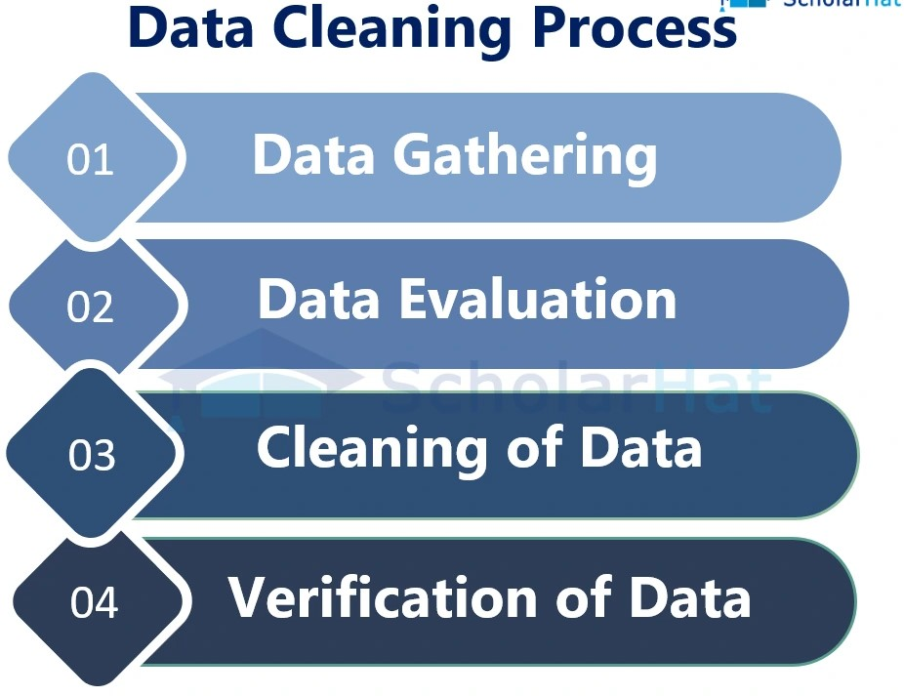

Slide 11
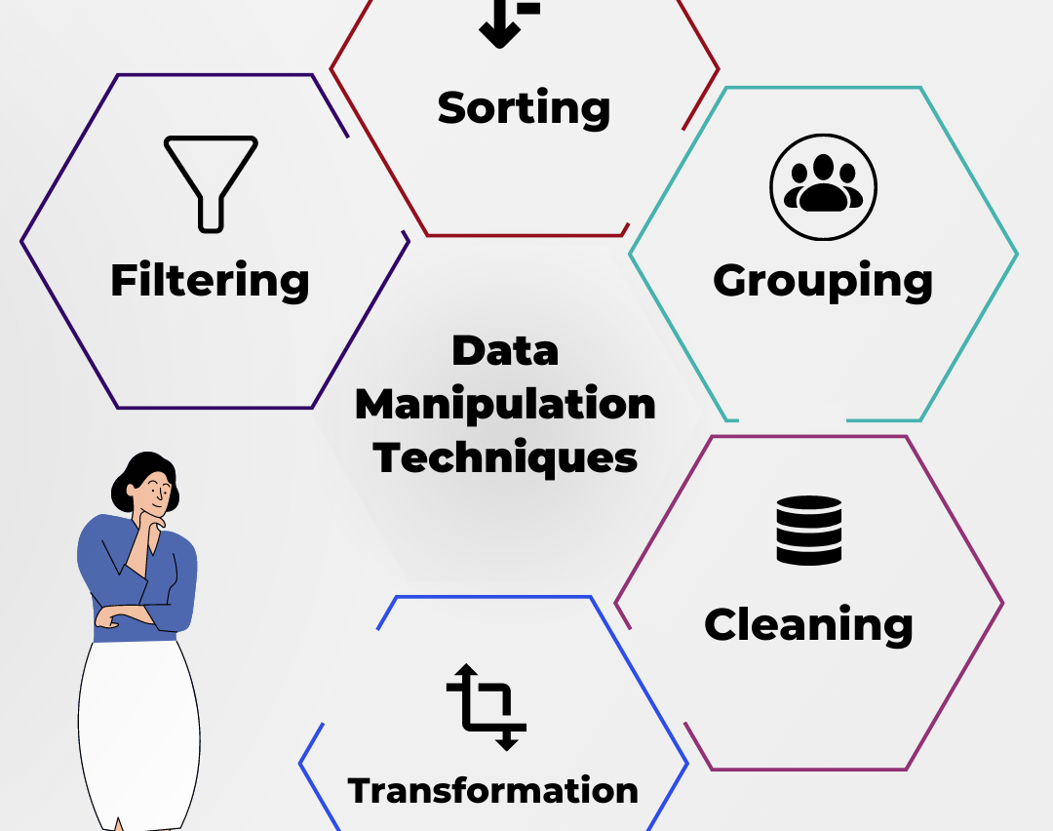
Data Manipulation

Slide 12
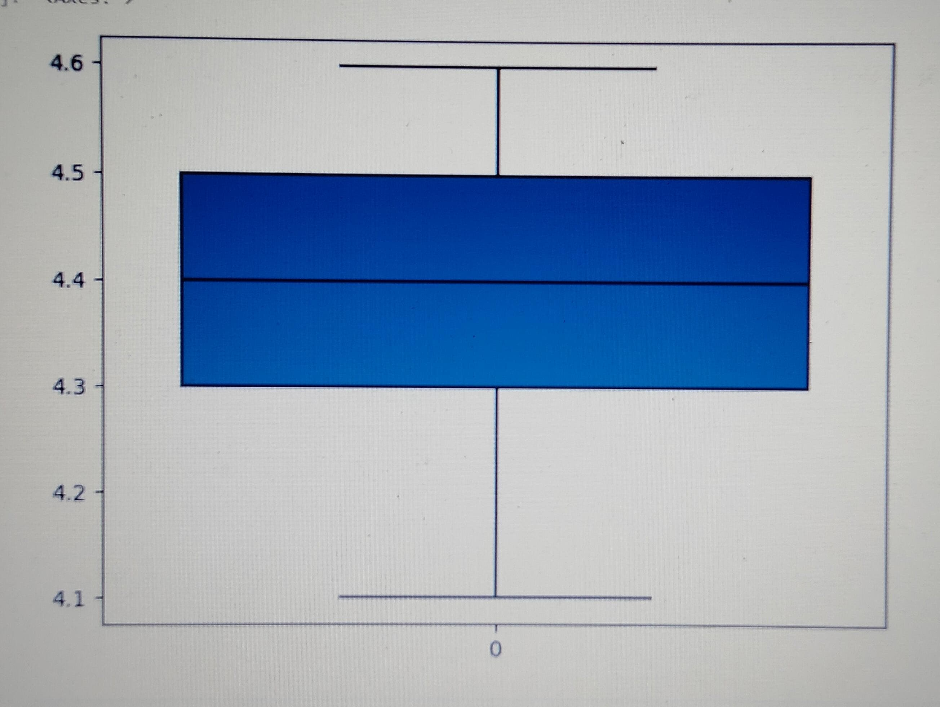
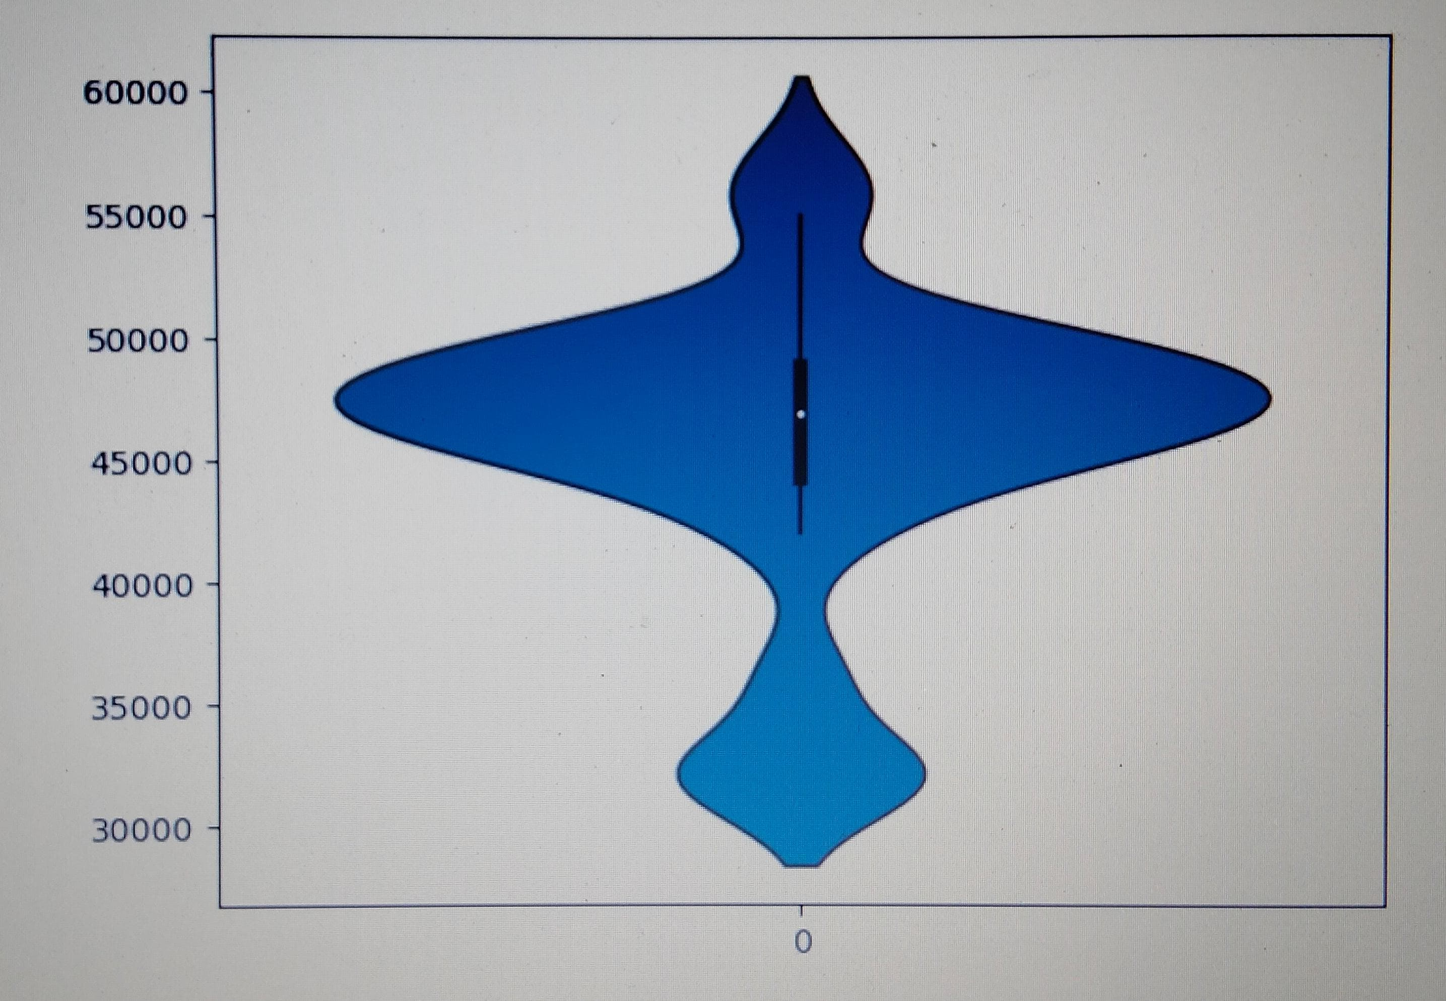
Univariate Analysis
#Based on the boxplot of product reviews, with the x-axis representing the count value and the y-axis representing #the product reviews. The boxplot shows that the majority of the product reviews are in the range between 4.3 and 4.5. The median value of the product #reviews is 4.4, which indicates that the product has a high demand in the market.
# from the above plot the x-axis represents the count and the y-axis represents the prices of the products here the prices are starting from 30k to 60k #but many are showing intrest to buy the price lies in between 40k to 55k but the median value for the prpoduct price is 46k.many people much showing #intrest to buy mobile with their desired features in a budget so here we can understand the mobile we get with all features in the budget of 46k

Slide 13
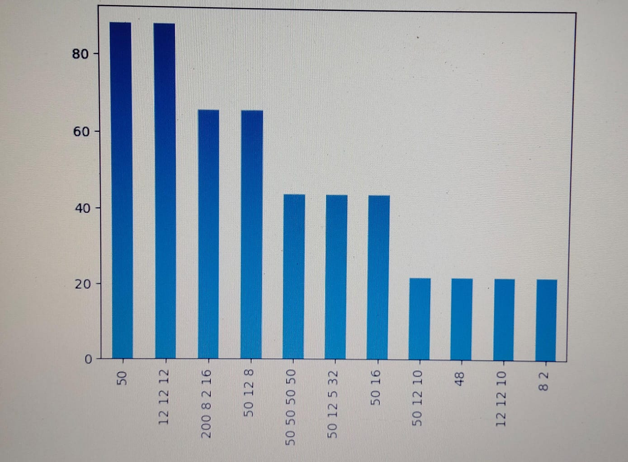
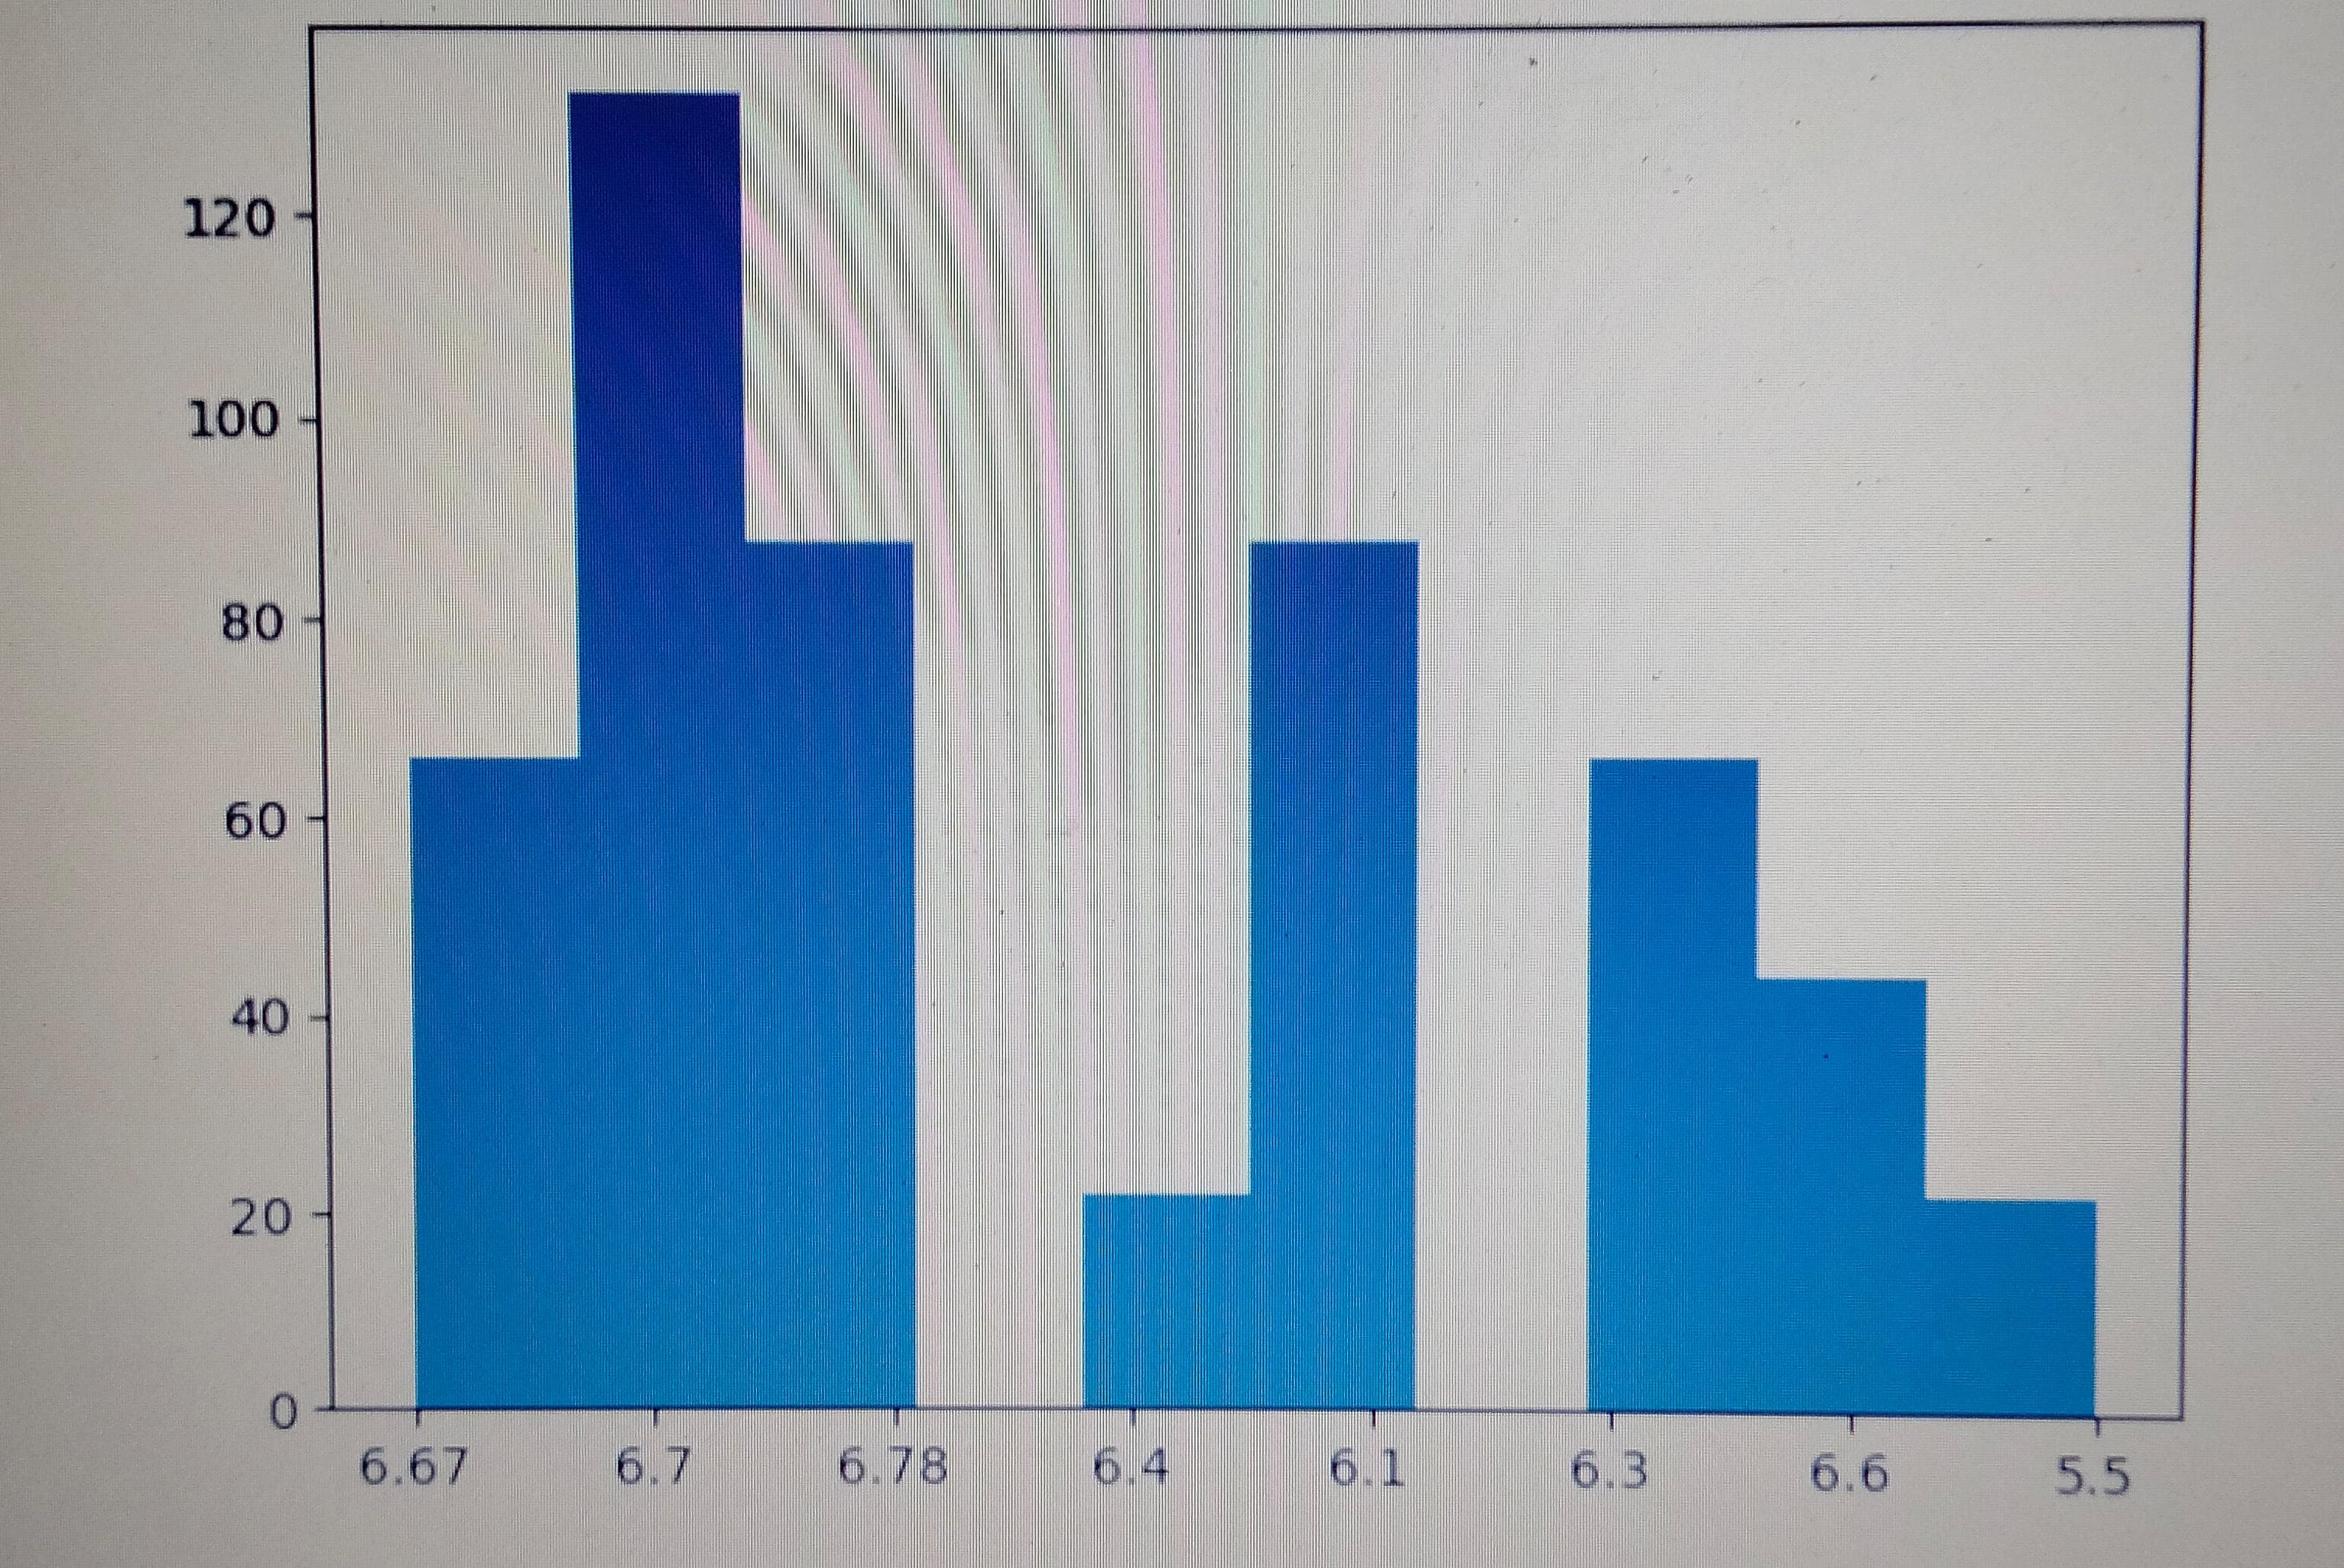
#from the graph the x-axis represents the size of the dispaly in inches and the y-axis represents the count.from that we can conclude that the max size#of the display is 6.7 and the min size of the display is 5.5,here what we can understand is the max usage mobile contains the dispaly size is 6.7
#the bar graph explains about the camera the x-axis represents the mp of camera and the y-axis represents the count. here two mp get the same counts #so here what we observe is two mobiles have the same demand in the market so we need to focus into those brands.

Slide 14
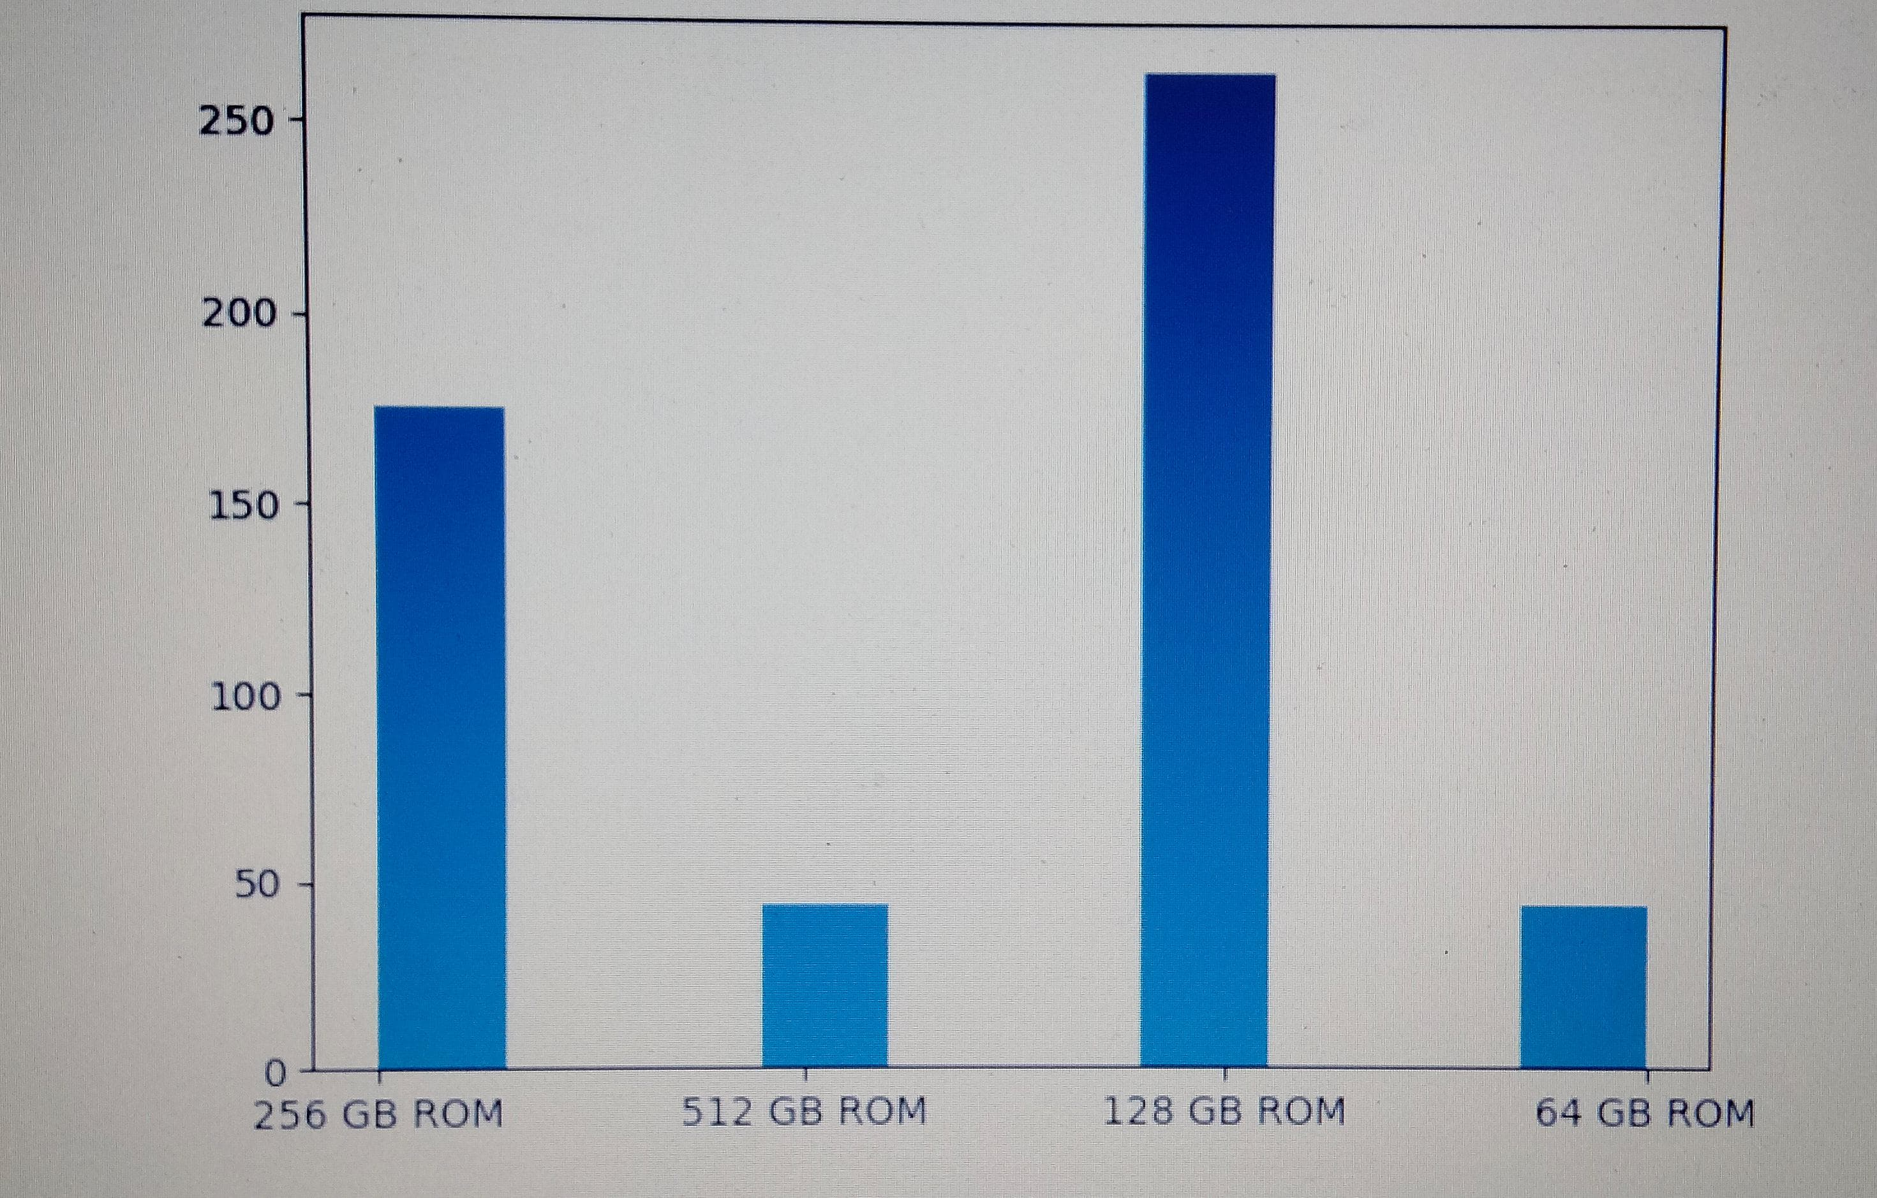
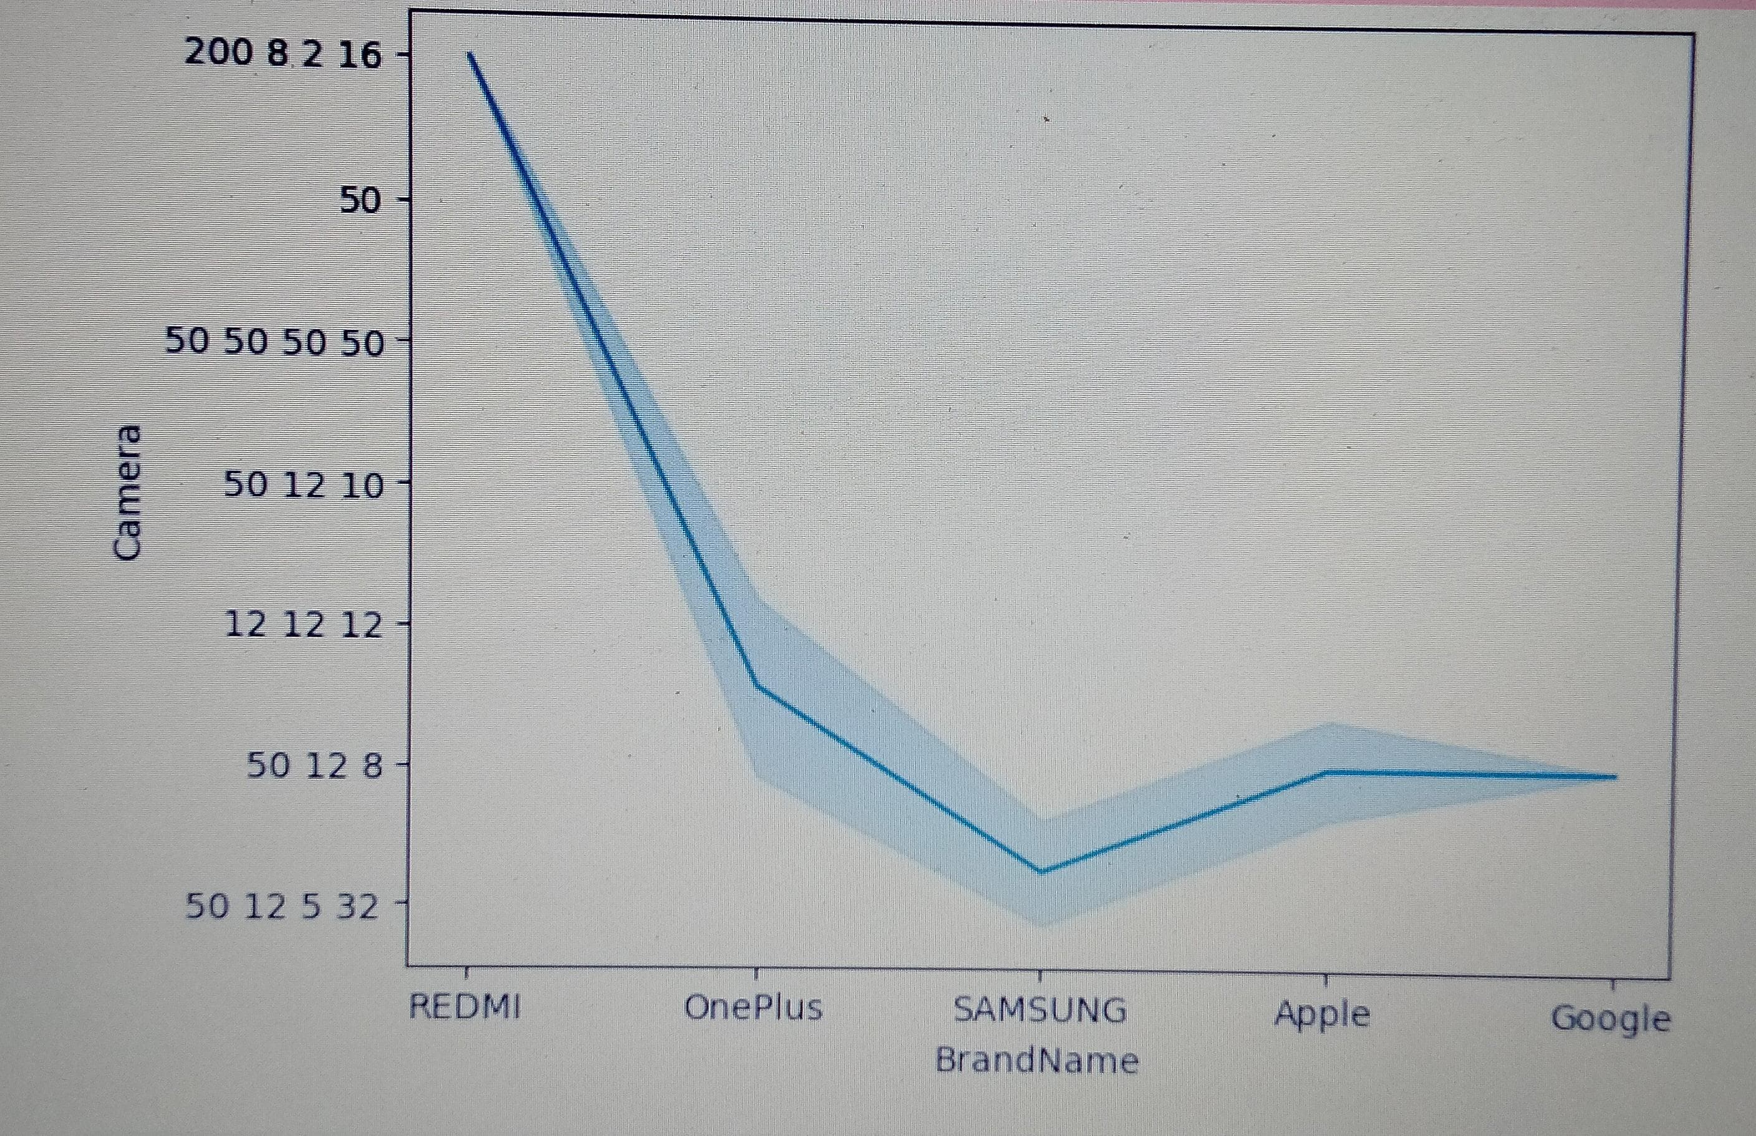
Bivarient analysis
# the line plot shows the x-axis represents the brand names and the y-axis represents the mega pixel count the graph represents the camera of each brand #and the camera mega pixel count foe easily analyze to compare the camera specifications with the other brands
#here the histogram plot represents the different sizes of ROM it lies on the x-axis and the counts are in the y-axis here if we observe the graph #the mostly mobiles containing 128 Gb ROM and the less mobiles contain 512 GB ROM the 128 GB ROM are available in one plus brand which is in friendly budget

Slide 15
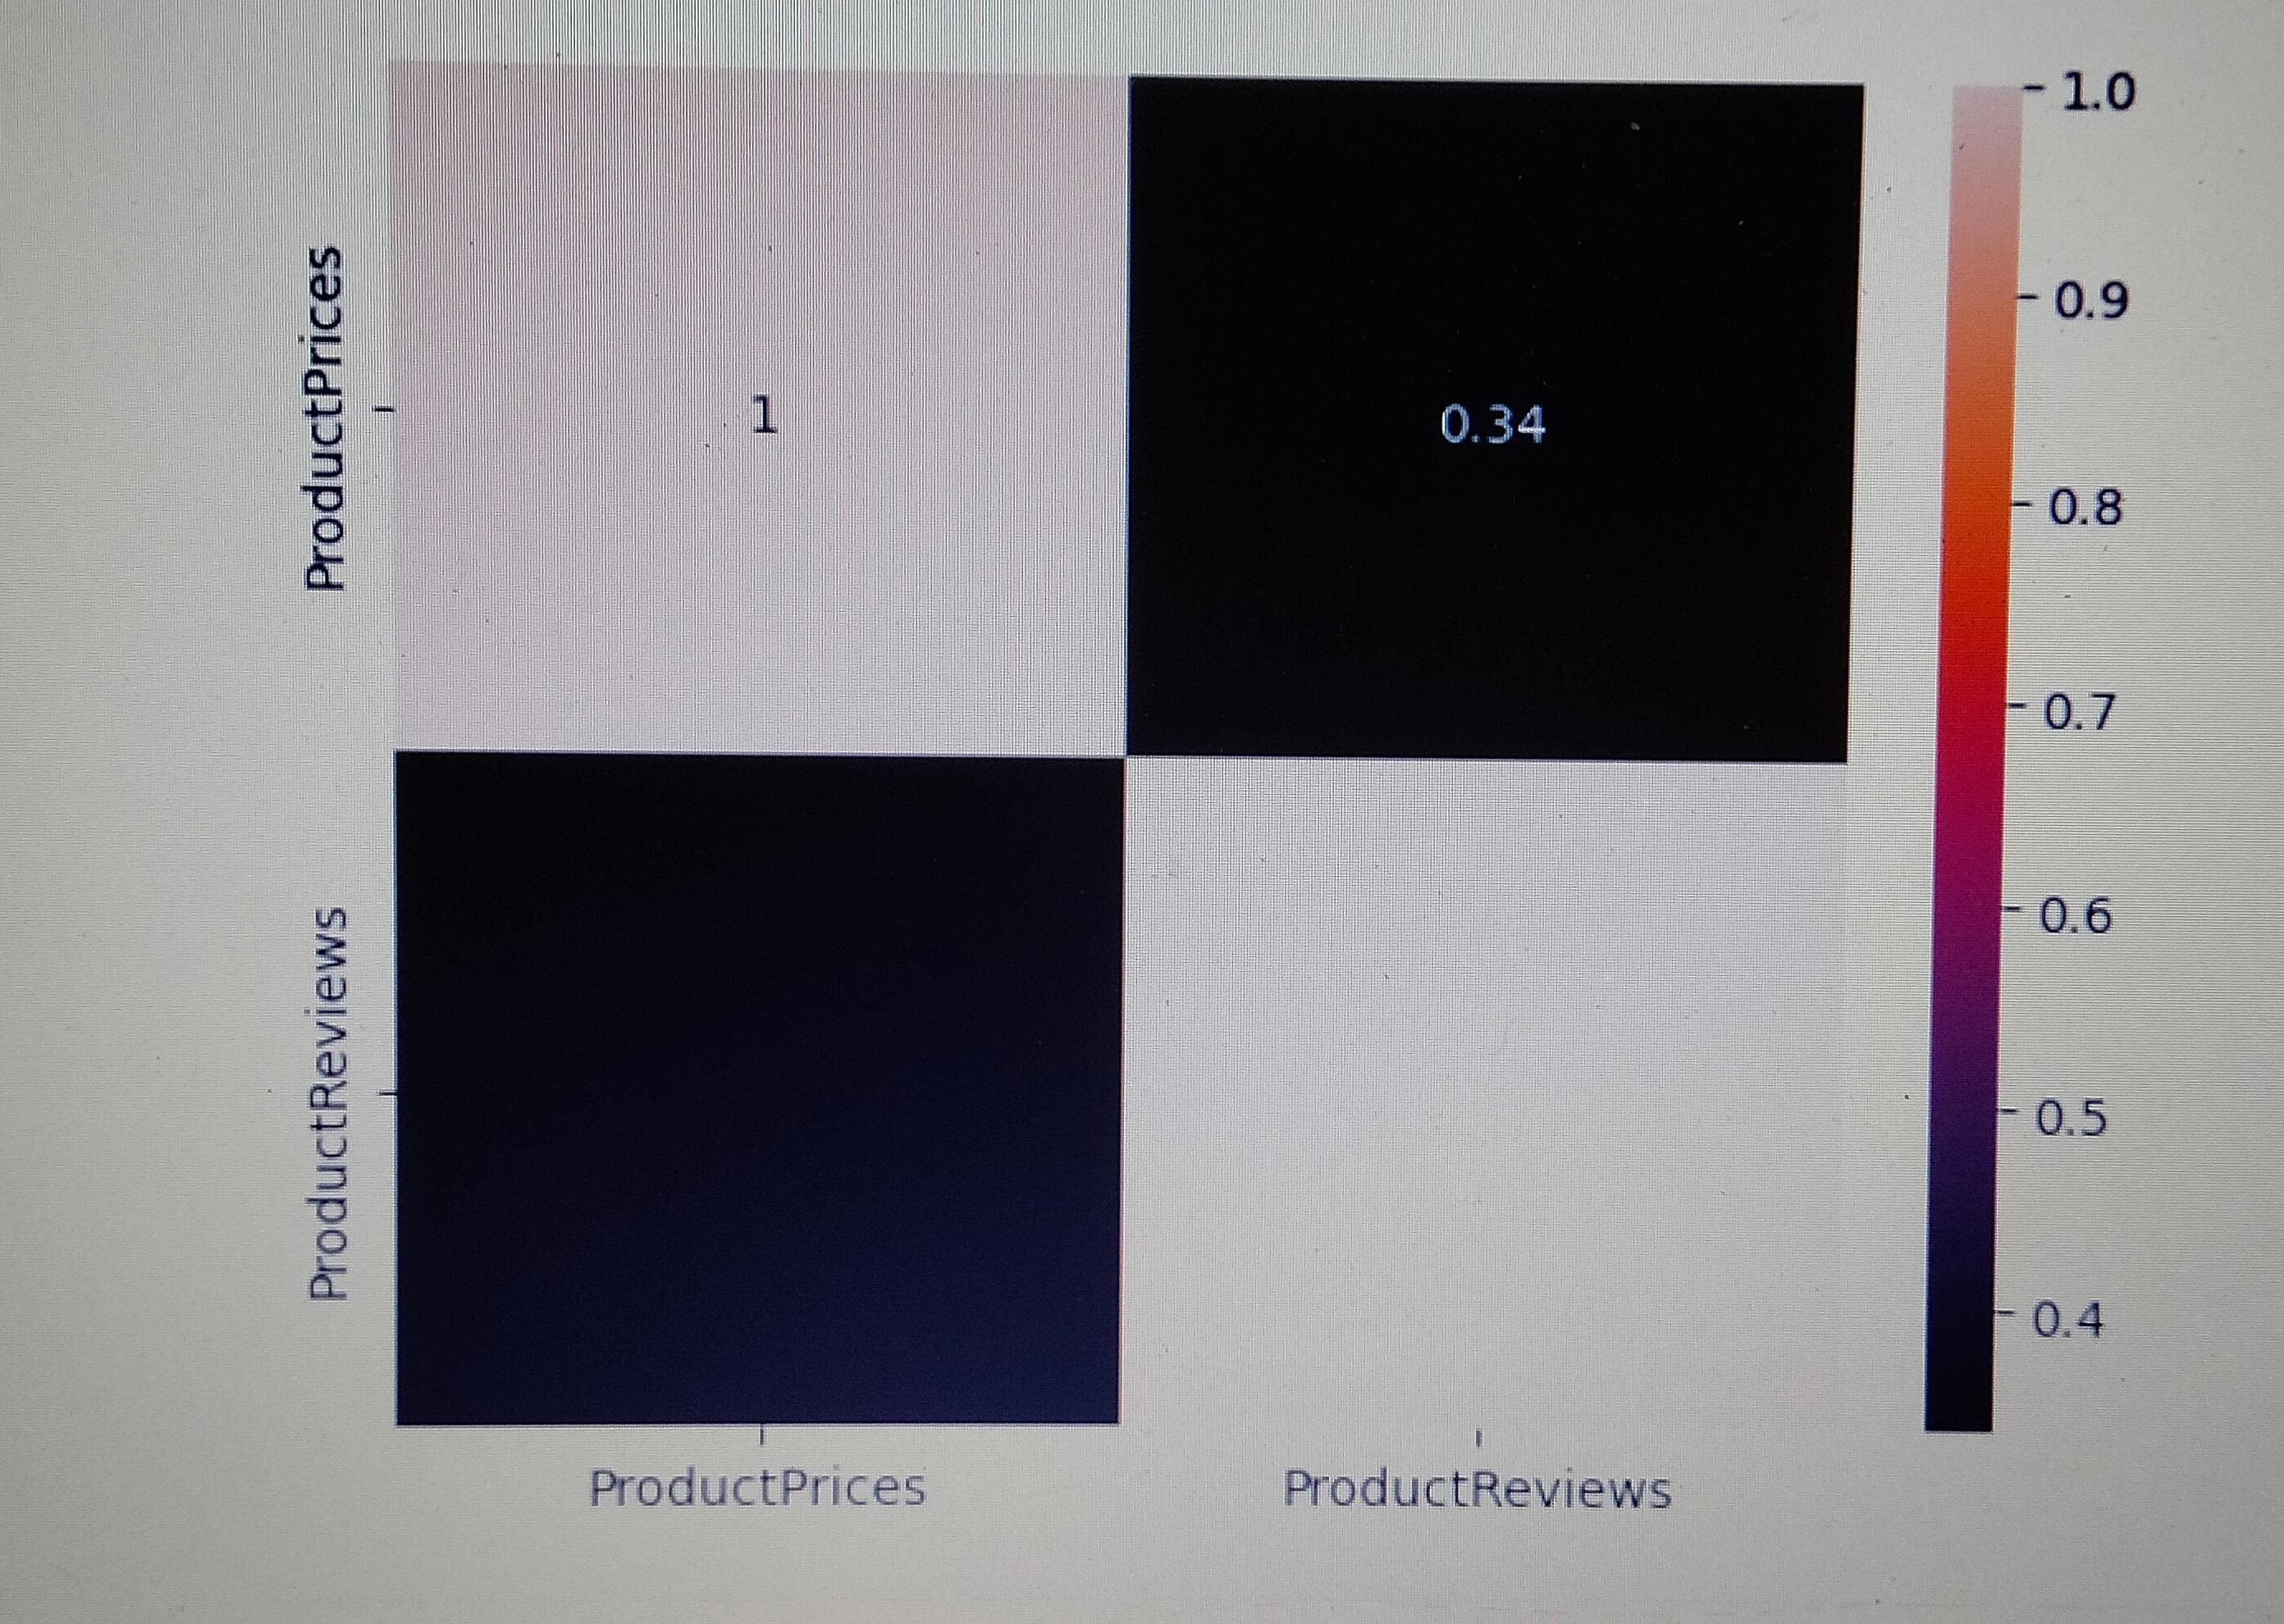
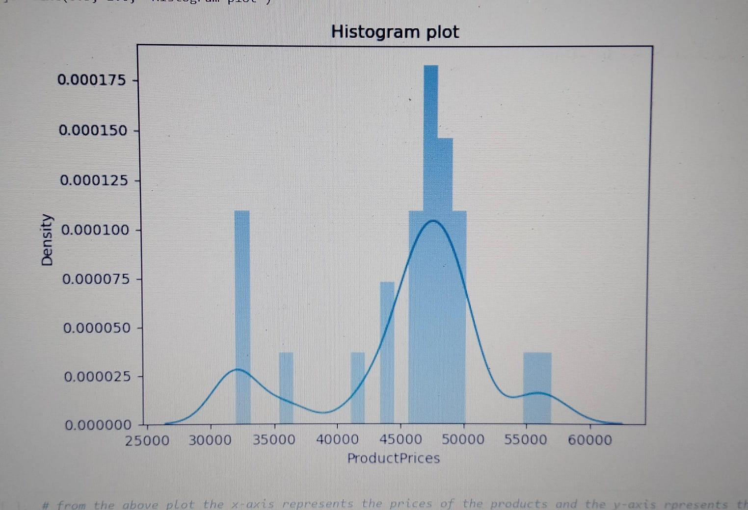
# from the above plot the x-axis represents the prices of the products and the y-axis rpresents the density here the prices are starting from nearly 27k to 60+k #but many are showing intrest to buy the price lies in between 45k to 50k but the median value for the prpoduct price is 46k.many people much showing #intrest to buy mobile with their desired features in a budget so here we can understand the mobile we get with all features in the budget of 46k
#heatmap is a graphical representation of data where values are represented as colors. the x-axis represents one variable, and the y-axis #represents another variable. In the case of a heatmap showing product prices and product reviews, the x-axis might represent different price ranges #and the y-axis might represent different review scores. The cells in the heatmap would then be colored based on the frequency or density of products #with a given price range and review score.

Slide 16
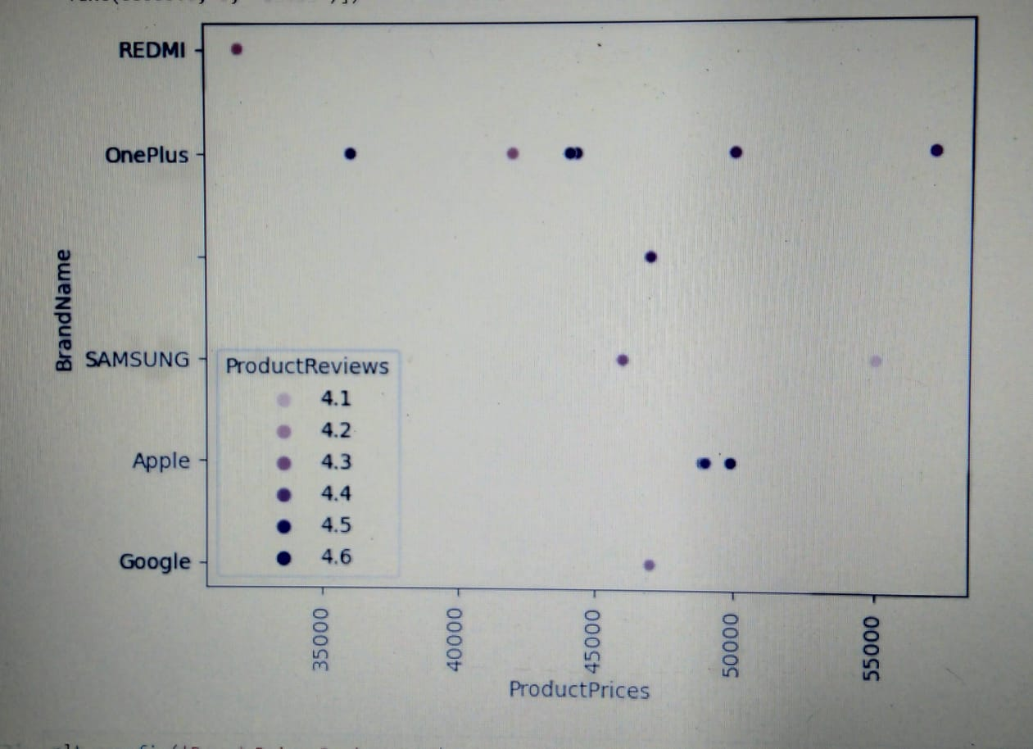
#the scatter plot reprsents the two variables i.e,Product prices and brand name x-axis contain product price and the y-axis contain brand name each point #of the scatter plot represents the combination of the product price and brand name the main thing we observe here is the x and y axis are corresponds #at one point it shows the product reviews based on that here we can easily identify which brand is available within a budget and contain best reviews #from this graph Oneplus is friendly budget and it contains 4.5 rating

Slide 17
Experience
During scraping the data I faced many times server error I used some headers request to overcome from that.

Slide 18
Key Business Question
1.What are the top three brands?
2.Which brand is available in all prices?
3.Which brand have high reviews?
Conclusion
Smart phones are Essential tools in our daily life they help us to communicate, socialize and interact with each other at any point in time. The consumers buying a variety of smartphones which satisfy their wants and they are always influenced by his purchasing activities by some considerations which leads to select a particular brand or a particular operating systems in preferred to others. From this study I collected some data from the website i.e. Flipkart to analyze and compare the data easily based on their features it gives some idea to the consumers easily. Here is the extracted and cleaned data in. Csv format , is useful to do data analysis on mobile phone purchases from the based on data i would like to suggest the brand OnePlus because from the analyzing data I observe Maximum of what the customers want is found in it and also it is available in within budget.

Slide 19


Slide 20


